Slide 1
Autonomous Traffic Flow Control through V2X Communication: A Research Study

Slide 2
Zeroth review
Project Guide:
Dr. A. Jackulin Mahariba
Assistant Professor (101370)
Project Team Members:
Aditya Chaturvedi (RA2011033010012)
Pratham Sahu (RA2011033010031)

Slide 3
Abstract
In the contemporary landscape of urban mobility, the convergence of autonomous In the contemporary landscape of urban mobility, the convergence of autonomous technologies and Vehicle-to-Everything (V2X) communication emerges as a pivotal avenue for refining traffic flow dynamics. This research undertakes a systematic exploration, focusing on the development of a robust theoretical model and innovative algorithmic frameworks for autonomous traffic management. Through rigorous simulation-based analyses, we assess the adaptability and performance of the proposed system in dynamic traffic scenarios. Ethical considerations, data privacy intricacies, and broader societal implications are meticulously examined. This research contributes nuanced insights and strategic recommendations, advancing the discourse on intelligent traffic control systems and fostering a safer and more optimized urban mobility eco-system. Technologies and Vehicle-to-Everything (V2X) communication emerges as a pivotal traffic flow dynamics. This research undertakes a systematic exploration, focusing on the development of a robust theoretical model and innovative algorithmic frameworks for autonomous traffic management. Through rigorous simulation-based analyses, we assess the adaptability and performance of the proposed system in dynamic traffic scenarios. Ethical considerations, data privacy intricacies, and broader societal implications are meticulously examined. This research contributes nuanced insights and strategic recommendations, advancing the discourse on intelligent traffic control systems and fostering a safer and more optimized urban mobility ecosystem.

Slide 4
Introduction
As our cities evolve and embrace the challenges of burgeoning urbanization, the paradigm of urban mobility is at the forefront of transformation. The amalgamation of rapid urban growth, technological innovation, and the inherent complexities of contemporary traffic congestion necessitates a reimagining of how we approach transportation. Within this landscape, we direct our focus toward the synergy of autonomous vehicles and the transformative potential of Vehicle-to-Everything (V2X) communication.
The rise of autonomous vehicles promises a future where transportation is not only driverless but intelligently orchestrated. In parallel, V2X communication introduces a dynamic layer, enabling vehicles to communicate not only with each other but with the entire urban infrastructure. This presentation aims to unravel the intricacies and potentials of marrying autonomy with communication for the purpose of revolutionizing urban traffic flow.

Slide 5
Literature Survey
Year of Publishing | Topic and Name of the | Inferences
2020 | Mixed Vertical-and-Horizontal-Text Traffic Sign Detection and Recognition for Street-Level Scene | The Chinese characters on text-based traffic signs are always in the form of a text line. There are both horizontal and vertical text lines.
2023 | A Traffic Sign Recognition Method Under Complex Illumination Conditions

Slide 6
Objective
1. Develop a Theoretical Model for Autonomous Traffic Management:
Explore the integration of Vehicle-to-Everything (V2X) communication protocols in the development of a robust theoretical framework.
Examine how autonomous vehicles can leverage this model for intelligent decision-making in diverse traffic scenarios.
2. Propose Innovative Algorithmic Frameworks for Real-Time Decision-Making:
Devise adaptive algorithms capable of making real-time decisions based on dynamic traffic conditions.
Address challenges such as scalability, responsiveness, and adaptability to ensure effectiveness in varying urban scenarios.

Slide 7
Objective
3. Evaluate System Performance through Rigorous Simulation-Based Analyses:
Utilize advanced simulation tools to assess the performance and efficiency of the proposed autonomous traffic flow control system.
Analyse results under diverse scenarios to validate the adaptability and robustness of the system.
4. Explore Ethical Considerations and Societal Impacts:
Investigate the ethical implications associated with autonomous traffic management, including issues of fairness, transparency, and accountability.
Evaluate the broader societal impacts, considering aspects of accessibility, inclusivity, and potential social transformations.

Slide 8
Proposed Architecture
Data Collection:
Autonomous vehicles collect real-time traffic data.
V2X Communication:
Enable communication between vehicles and infrastructure.
Centralized Decision System:
Central system processes data and makes traffic flow decisions.
Decision Broadcast:
Broadcast decisions to all connected vehicles.
Vehicle Adaptation:
Autonomous vehicles adapt based on received decisions.

Slide 9
Proposed Modules
Data Collection:
Module responsible for collecting real-time traffic data from autonomous vehicles.
Communication Module:
Facilitates V2X communication, enabling data exchange between vehicles and infrastructure.
Decision Engine:
Central module that processes incoming data and makes decisions for traffic flow optimization.
Broadcast Module:
Handles the broadcast of decisions to all connected vehicles within the V2X network.
Vehicle Adaptation Module:
Enables autonomous vehicles to receive and adapt routes and speeds based on decisions.

Slide 10
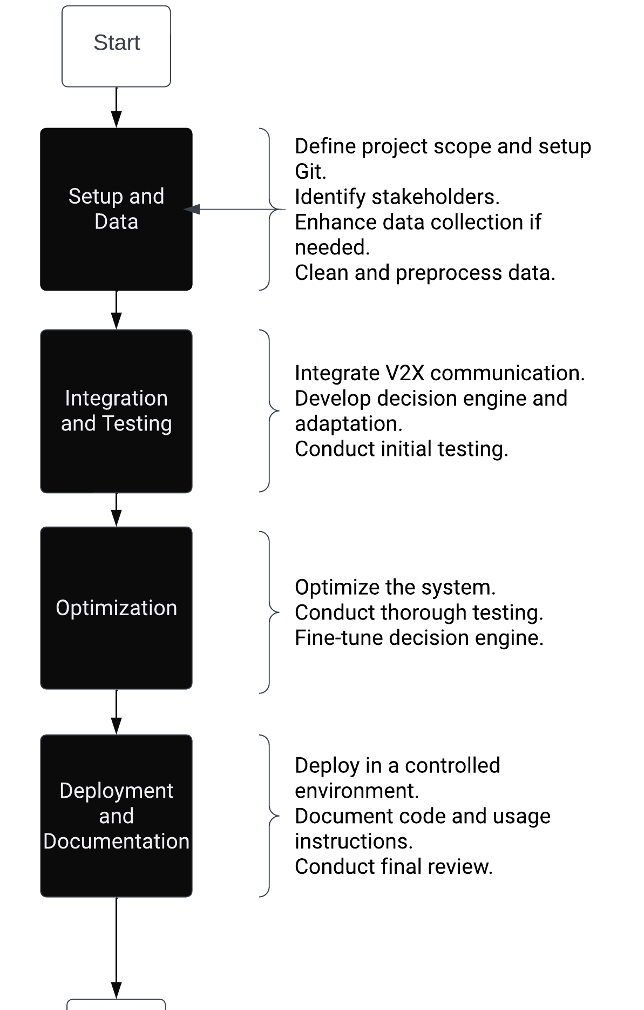
Plan Of Action(POA)

